Slide 1
Doxygen Introduction
Wenjie, Wang

Slide 2
Agenda
Doxygen Installation
Doxygen Configuration
Doxygen Mark Commands
Doxygen Group

Slide 3
Installation
Binary release:
https://www.doxygen.nl/download.html
Compile from source
wget doxygen-$VERSION.srg.tar.gz
cd doxygen-$VERSION
mkdir build
cd build
cmake -G "Unix Makefiles" ../
cd ../
make
make install

Slide 4
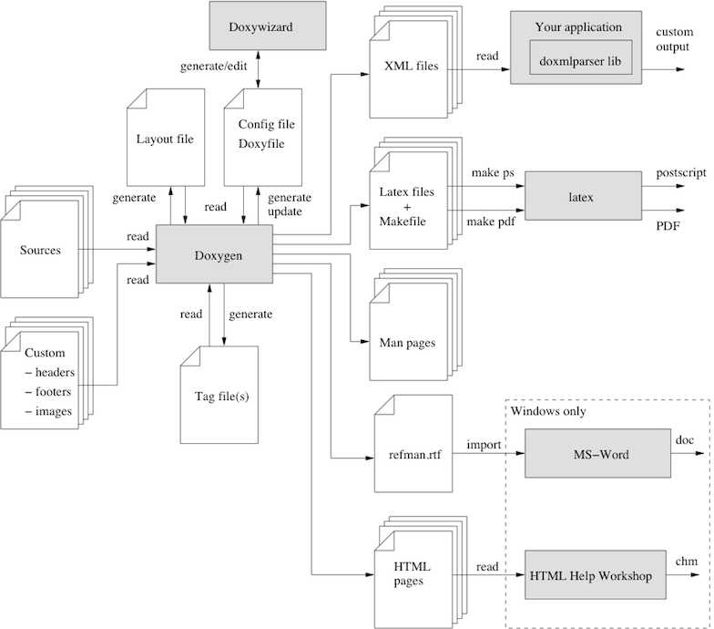
Introduction
Doxygen automates the generation of documentation from source code comments, parsing information about classes, functions, and variables to produce output in formats like HTML and PDF.
By simplifying and standardizing the documentation process, Doxygen enhances collaboration and maintenance across diverse programming languages and project scales.

Slide 5
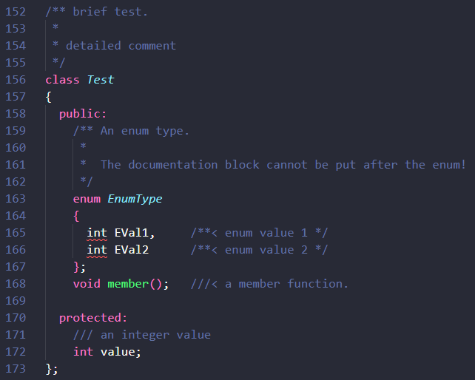
Documentation Component
Brief
The brief description for a file, struct, union, class, enum, or method
Detail
The detailed description for a file, struct, union, class, enum, or method
Member
The inlined comment for the members of a file, struct, union, class, or enum

Slide 6
Common Commands
@file
@author
@email
@version
@date
@license
@brief
@detail
@param
@return
@ref
@cite
@sa
@exception
@warning
@attention
@note
https://www.doxygen.nl/manual/commands.html

Slide 7
Configuration
INPUT
FILE_PATTERNS
RECURSIVE
EXCLUDE
EXCLUDE_PATTERNS
SOURCE_BROWSER
INLINE_SOURCES
OUTPUT_DIRECTORY
HTML_OUTPUT
RTF_OUTPUT
LATEX_OUTPUT
XML_OUTPUT
MAN_OUTPUT
DOCBOOT_OUTPUT

Slide 8
Markdown Support
Lists
Bullet list
Minus list
Asterisk list
Plus list
Numbered list
Mannul numbered
Autonumberd: -#
Links
Inline link
Link to web url
Link to local html
Link with attribute
Reference link
Automatic Link
Images
Inline link
Reference link
Image attribute.
Set width, height …
Headers
Header id
Block quotes
Code Blocks
Horizontal Rulers
Emphasis
Strikethrough
Code spans
Tables
Fenced Code Blocks

Slide 9
Grouping
\defgroup
\addtogroup
Create if not exists
Add to group
\ingroup
“@{“ and “@}” automatically add to a group
\weakgroup
Lowest priority
Use \defgroup in .h and \weakgroup in .c
Priority
\ingroup > \defgroup > \addtogroup > \weakgroup
Warning
Compound entities(classes, files, namespaces) can be put into multiple groups
Members(variable, functions, typedefs, enums) only in one group
https://www.doxygen.nl/manual/grouping.html

Slide 10
Page
\mainpage
\page
Create if not exists
Add to group
\subpage
“@{“ and “@}” automatically add to a group

Slide 11
Automatic Link
Link to class
The Words containing at least one non-lowercase character will automatically linked
Use @ref to link
Link to file
The words that contain a dot and can be interpreted as a file will the automatically linked.
Link to function
<functionName>"("<argument-list>")"
<functionName>"()"
"::"<functionName>
(<className>"::")<functionName>"("<argument-list>")"
(<className>"::")<functionName>"("<argument-list>")"<modifiers>
(<className>"::")<functionName>"()"
(<className>"::")<functionName>
https://www.doxygen.nl/manual/autolink.html

